Slide 1
Stumbling on Happiness
Dr. Martin Rovers
Capital Choice Counselling Group
Reesa Packard
St Paul University PhD Candidate

Slide 2
Know Thyself
Please write 3 words, or short sentences on what you wish to achieve or learn by coming to this talk?
1)
2)
3)

Slide 3
Happiness
Happiness is a mental state of well-being characterized by positive emotions ranging from contentment to intense joy. A variety of biological, psychological, religious, and philosophical approaches have striven to define happiness and identify its sources
https://www.youtube.com/watch?v=yHFDa9efCQU

Slide 4
Happiness
Happiness is when what you think, what you say, and what you do are in harmony. (Mahatma Gandhi)
Happiness is that state of consciousness which proceeds from the achievement of one’s values. (Ayn Rand)
Happiness is something that you are and it comes from the way you think. (Wayne Dyer)
Happiness is essentially a state of going somewhere, wholeheartedly, one-directionally, without regret or reservation.(William H. Sheldon)
Happiness is not a reward – it is a consequence. (Robert Ingersoll)

Slide 5
Happiness
Happiness is the meaning and the purpose of life, the whole aim and end of human existence. (Aristotle)
Happiness is not something you experience, it’s something you remember. (Oscar Levant)
Happiness is not a station you arrive at, but a manner of traveling. (Margaret Lee Runbeck)
Happiness is the spiritual experience of living every minute with love, grace and gratitude. (Denis Waitley)

Slide 6
Happiness
What is happiness?
Positive affect
Subjective well-being
The good life (Aristotle)
Temperance
The opposite of happiness is unhappiness, not depression or sadness
Everyone wants to be happier!!!!!!

Slide 7
Happiness
All in all, I would say that happiness is a decision. Your happiness is your decision to make. All the quotes above require actions on our part and actions require decisions.

Slide 8
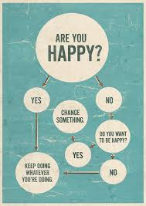

Slide 9
Does one in fact “stumble” upon happiness?
Differentiating between:
a state that may occur suddenly and at random,
a condition being constructed, and
a way of life having been chosen and subsequently becoming established
Do we have the power to chose? If not, can we become empowered?
Intentionality and activation of behaviours
The role of language and the creation of meaning
Facial Feedback Hypothesis (Strack, 1988)
The Good News…

Slide 10
Positive Psychology – an introduction
Martin Seligman : how individuals thrive
Strengths-based and concerned with virtues
Idea that focus upon the disorder or distress captures only a part of the whole person
“The Good Life” – what makes it so?
Wellness = psychological, social, and emotional functioning + low dysfunction (mental illness)

Slide 11
Positive Experiences
Feelings of pleasure - states of flow and peak experiences
Awe and wonder
- Video clip
- Striving for balance; Coping and Perspective
- Striving for resilience; Internal Resources
- Striving for connection; Who am I?
Play?... Why not?

Slide 12
Eastern Perspectives
Two causes of suffering
1. ?
2. ?
Neutrality and moderation
Extremes and pendulum swings: special, ecstatic, etc.
Peace of mind
Kindness (experiment)
True Nature

Slide 13
Authentically, you?

Slide 14
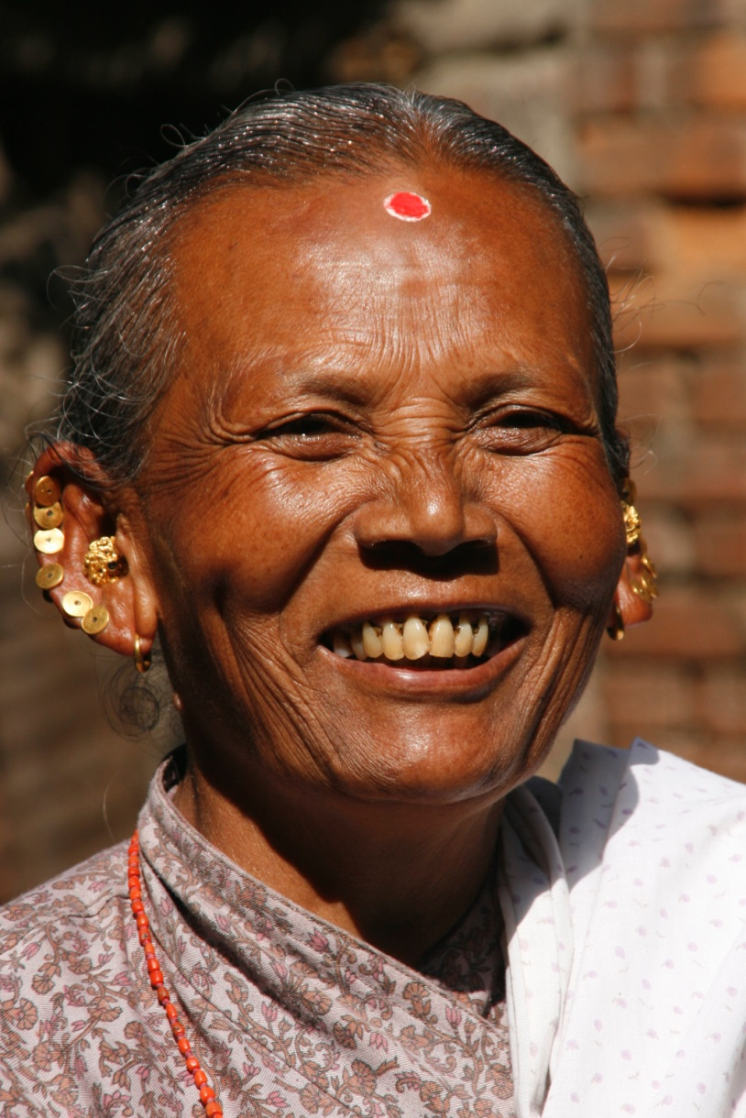
Authentic Smile
?

Slide 15
Duchenne Smile
There are basically two types of smiles:
1 - the genuine smile is called the "Duchenne smile,"
The Duchenne smile involves both voluntary and involuntary contraction from two muscles: the zygomatic major (raising the corners of the mouth) and the orbicularis oculi (raising the cheeks and producing crow's feet around the eyes).
2) - A fake smile or a "Say Cheese" smile
involves the contraction of just the zygomatic major since we cannot voluntarily contract the orbicularis oculi muscle.
The Duchenne smile people have more personal life satisfaction all throughout life, more satisfying marriages, live longer …

Slide 16
Practicing Happiness
To be happier, you have to think about feeling good, feeling bad, and feeling right, in an atmosphere of growth.
The only person I can change is myself.

Slide 17
Practicing Happiness
Happiness is a by-product of an effort to make someone else happy.
One of the best ways to make yourself happy is to make other people happy; One of the best ways to make other people happy is to be happy yourself.
You’re not happy unless you think you’re happy.

Slide 18
Practicing Happiness
The days are long, but the years are short.
http://www.theyearsareshort.com

Slide 19
Practicing Happiness
We can travel a long way and do many things, but our deepest happiness is not born from accumulating new experiences. it is born from letting go of what is unnecessary, and knowing ourselves to be always at home.
I need to let go of and forgive……

Slide 20
Practicing Happiness
The supreme happiness of life is the conviction that we are loved….. That we have enough “contact comfort”.
Study of happiness by length of years married

Slide 21
Why Me?
Life: a thousand sorrows and a thousand joys
Pain is inevitable (unloved, abuse, struggle)
Suffering arises from our relationship to the pain that life sends us. It is about the way I deal with / think about the pains of my life.
Suffering: Why me?
“Actually, it has nothing to do with you” (Buddha)
Making my container larger to hold life!

Slide 22
Authentic Happiness … Martin Seligman
Is it possible to make myself happier?
50% of happiness is genetic:
10-15% is life circumstances, like age, gender, marital status, income, spirituality, democracy, social networks, etc.
The rest is a matter of how one thinks and acts:
Our signature strengths
We each have a happiness range and I can move myself up to the higher reaches of my range.

Slide 23
Authentic Happiness
Relationships
People who have one or more close friendships are happier. It doesn’t seem to matter if we have a large network of close relationships or not. What seems to make a difference is if and how often we cooperate in activities and share our personal feelings with a friend or relative.
I want to call my friend ____ today…..

Slide 24
Authentic Happiness
Caring
People who volunteer or simply care for others on a consistent basis seem to be happier and less depressed. Although “caring” can involve volunteering as part of an organized group or club, it can be as simple as reaching out to a workmate or classmate who looks lonely or is struggling with an issue.
Who needs me to care today….

Slide 25
Authentic Happiness
Exercise
Regular exercise has been associated with improved mental well-being and a lower incidence of depression. The Cochrane Review has produced a landmark analysis of 23 studies on exercise and depression. One of the major conclusions was that exercise had a “large clinical impact.”
My New Years exercise resolution is….

Slide 26
Authentic Happiness
Flow
If we are deeply involved in trying to reach a goal, or an activity that is challenging but well suited to our skills, we experience a joyful state called “flow” or energy.
One goal for this year is…..

Slide 27
Authentic Happiness
Spiritual Engagement and Meaning
Studies demonstrate a close link between spiritual and religious practice and happiness and hope is the greatest virtue of all.
I have come to believe in a power greater than myself……

Slide 28
Authentic Happiness
Strengths and Virtues
Studies show that the happiest people are those that have discovered their unique strengths (such as persistence and critical thinking) and virtues (such as humanity or justice) and use those strengths and virtues for a purpose that is greater than their own personal goals.
One strength / virtue I have is…..

Slide 29
Authentic Happiness
Positive Thinking: Optimism and Gratitude
Of all the areas studied, gratitude has perhaps received the most attention. Grateful people have been shown to have greater positive emotion, a greater sense of belonging, and lower incidence of depression and stress.
My Story for coming …
The Nun Study…..
Three people / things I am grateful for…..

Slide 30
Satisfaction with Life Scale
Below are five statements that you may agree or disagree with. Please be open and honest in your responding.
7 – Strongly agree 6 – Agree 5 – Slightly agree 4 – Neither agree nor disagree 3 – Slightly disagree 2 – Disagree 1 – Strongly disagree
____ In most ways my life is close to my ideal.
____ The conditions of my life are excellent.
____ I am satisfied with my life.
____ So far I have gotten the important things I want in life.
____ If I could live my life over, I would change almost nothing.

Slide 31
Satisfaction with Life Scale
Add up your results and see where you are in the following list: 35 – 31 – Extremely satisfied 26 – 30 – Satisfied 21 – 25 – Slightly satisfied 20 – Neutral 15 – 19 – Slightly dissatisfied 10 – 14 – Dissatisfied 5 – 9 – Extremely dissatisfied

Slide 32
The Happiness Project by Gretchen Rubin, (2009)
12 Steps to Happiness …one per month!
Vitality ... eat well, sleep well, exercise well, get it done now,
Marriage ... quit nagging, fight right, no dumping, give proofs of love
Aim Higher ... work smart, ask for help, enjoy now, accept failure
Parenthood ... hugs, touch and I love you, praise, waste time,
Be Serious about Play ... find more fun, take time to be silly, go off the path,
Make time for Friends .... be generous, remember birthdays, don’t gossip, make a new friend,
Buy some Happiness ... splurge on something, give up something,
Contemplate the Heavens ... learn some spiritual masters, be grateful, wonder,
Pursue a Passion ... master a new ability, read, write a book, forget about results,
Pay Attention ... mindfulness, mediate on life,
Keep a Contented Heart ...attitude, laugh out loud, give positive reviews,
Boot Camp Perfect ... the work of love, a life project, seek happiness

Slide 33
Happiness is a state of mind. ... Self-Unfolding by Swami Chinmayananda (2007)
When the mind is agitated, we feel sorrow or anxiety.
When the mind is tranquil, we feel joy and happiness.
Thus, happiness is measured by the tranquility of our mind.

Slide 34
Happiness and Expectations
Lasting joy comes from our state of gratification: we are satisfied and gratefully,
I have what I need.
Happiness = number of desires fulfilled / number of desires entertained or expected.
You can increase happiness by increasing the number of desires fulfilled
Or by decreasing the number of desires entertained or expected.
With one caution: fulfilling my desires often causes more desires..... and there has to be a balance.
If we expect TOO MUCH in comparison to what we are fulfilled by = unhappiness
If we are happy with what we have = more happiness.
Thus is it not that I get everything I want, but that I want everything I now have: enjoy the moment.
Story of the optimist and pessimist

Slide 35
Flow: The Psychology of Optimal Experience
“The best moments in our lives are not the passive, receptive, relaxing times… The best moments usually occur if a person’s body or mind is stretched to its limits in a voluntary effort to accomplish something difficult and worthwhile.” ~ Mihaly Csikszentmihalyi (1990, p. 3)

Slide 36
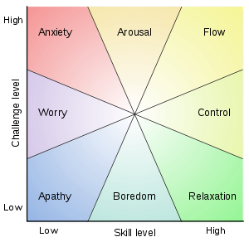

Slide 37
Happiness
Getting into the flow of life
Thank You

